Slide 1

STUDENTS PERFORMANCE
PREDICTION

Slide 2
INTRODUCTION
1
2
3
Project Focus
Motivation
Support System
Understanding and predicting student academic performance using analytical and machine-learning techniques.
Identify factors influencing final exam scores and provide data-driven insights for educational decision-making.
Aid teachers, parents, and institutions in improving student outcomes with a predictive system.

Slide 3


PROBLEM STATEMENT
Student performance is affected by multiple factors like study habits, attendance, parental background, and personal behavior. Institutions often struggle to identify which factors matter most.
Analytical Problem
Business Problem
Determine the key variables that significantly influence final exam scores.
Build an accurate predictive model to help stakeholders take early, informed action.

Slide 4
DATASET OVERVIEW
Our dataset provides comprehensive information on various aspects influencing student achievement.
Detailed Information
Key Variables
Student demographics
Features: study time, previous scores, attendance, parental education
Academic performance & study habits
Attendance levels
Target Variable: Final exam score
Parental education & support
Environmental factors

Slide 5
EXPLORATORY DATA ANALYSIS (EDA)
Visualizing data reveals critical relationships between various factors and student performance.
Key Visuals
Key Observations
Histogram of scores: Distribution insight
Increased study hours ➜ higher scores
Heatmap: Variable correlations
Good attendance ➜ improved results
Boxplot: Parent Education vs. final score
Parental education ➜ positive correlation
Scatter plot: Study hours vs. final score
Some features showed weak relation

Slide 6
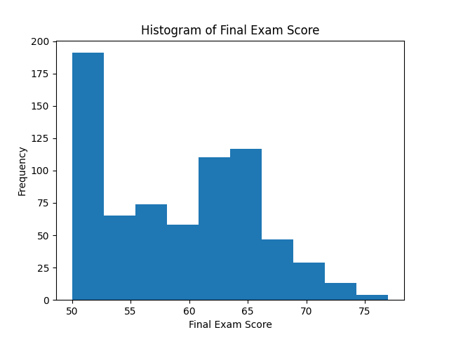
HISTOGRAM
This histogram illustrates the distribution of final exam scores, offering a clear view of student performance across the dataset.

Slide 7
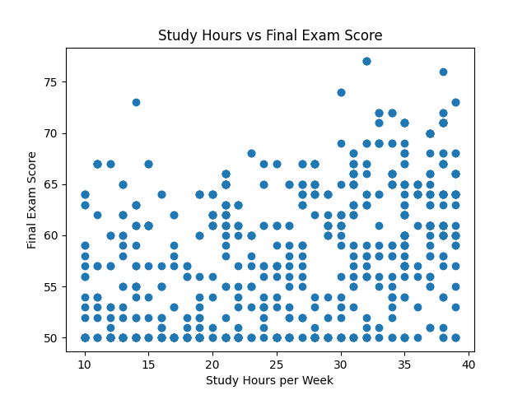
SCATTER PLOT
The scatter plot above visualizes the relationship between study hours and final scores, highlighting how consistent presence often correlates with better academic outcomes.

Slide 8
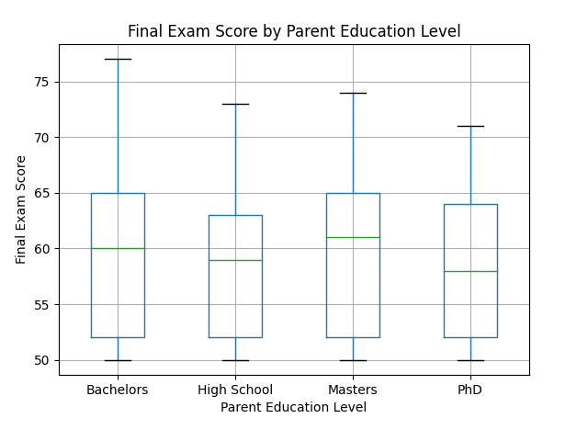
BOX PLOT
This box plot compares parent education level with student performance, demonstrating the impact of dedicated study time on final exam results.

Slide 9
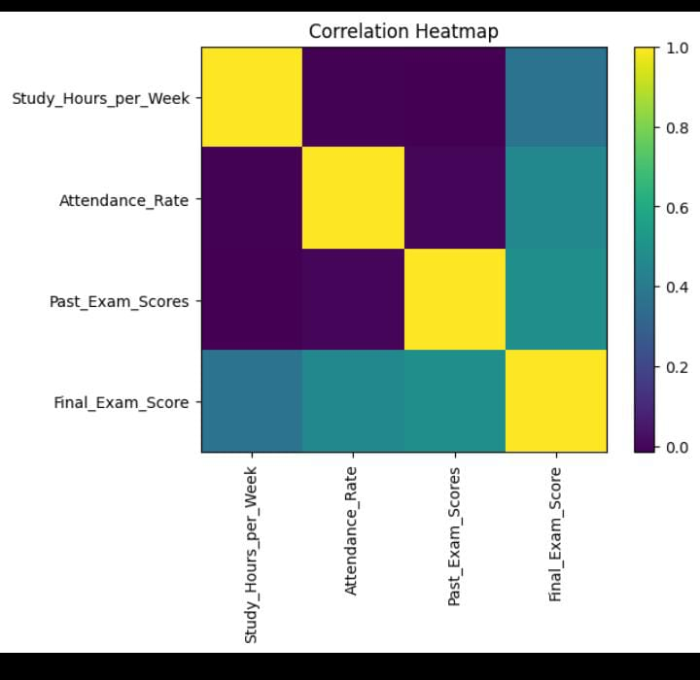
HEAT MAP
The heatmap displays the correlation matrix between various features, allowing us to quickly identify strong and weak relationships within the dataset.

Slide 10
MODEL SELECTION & RESULTS
We evaluated several machine learning algorithms to identify the most effective predictive model.
Algorithms Implemented
Performance Metrics
Linear Regression
R² Score
KNN
Decision Tree
Random Forest
SVR
Gradient Boosting Regression
MAE (Mean Absolute Error)
RMSE (Root Mean Squared Error)
Best Model: Random Forest
Random Forest Regressor consistently predicted scores with the highest accuracy and lowest error rates.

Slide 11
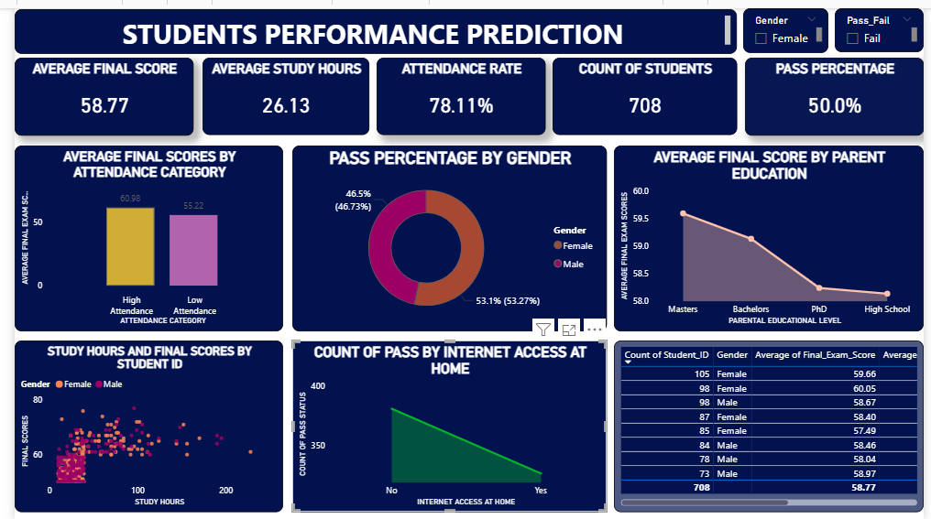

Slide 12








DASHBOARD INSIGHTS
Our interactive dashboard provides dynamic visualizations for actionable insights.
Score Distribution
Study Hours Impact
Visualize the spread of student scores across cohorts.
Compare how study time influences academic outcomes.
Key Factor Analysis
Student Segmentation
Identify the most influential variables affecting performance.
Categorize students for targeted interventions and support.

Slide 13
CONCLUSION
Key Predictors
EDA's Role
Study hours, attendance, and parental background are major performance indicators.
Crucial for understanding the strongest influencing factors.
Predictive Power
Actionable Insights
Machine learning models effectively forecast final exam scores.
Inform interventions and improve academic results for institutions.

Slide 14
THANK YOU

